Slide 1
How are the presentations scored?
5 min to present your scenario
A scale of 1-10 for each:
Transformational Value
Business Impact
Adoption Potential
Workflow Design
Presentation
Would You Sponsor It?
How much does this workflow change the way people work, deliver services or achieve outcomes?
Who does the workflow Benefit and how does it benefit them?
How likely is it that users would use this solution?
How well thought-out and realistic is the workflow’s design for its intended purpose?
How effectively did the team communicate the problem, solution and value of their Workflow?
How strongly would leadership support investing in and deploying the Workflow?
5 min for each presentation with QnA

Slide 2
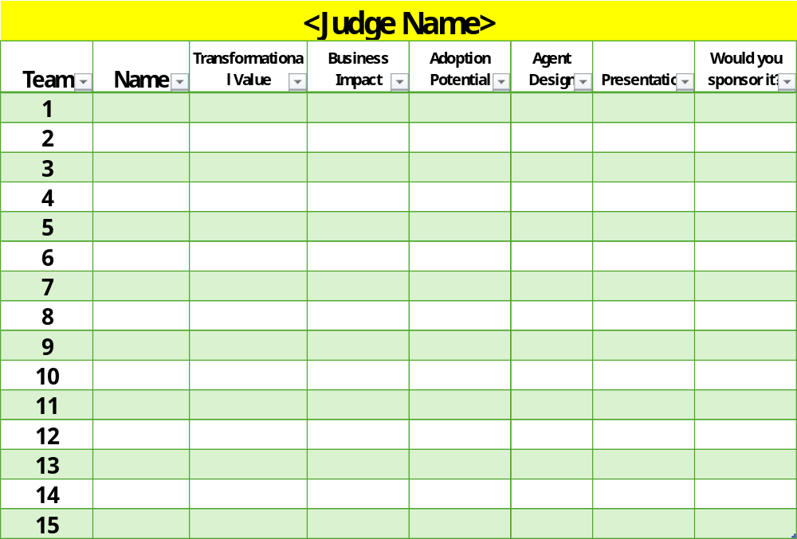
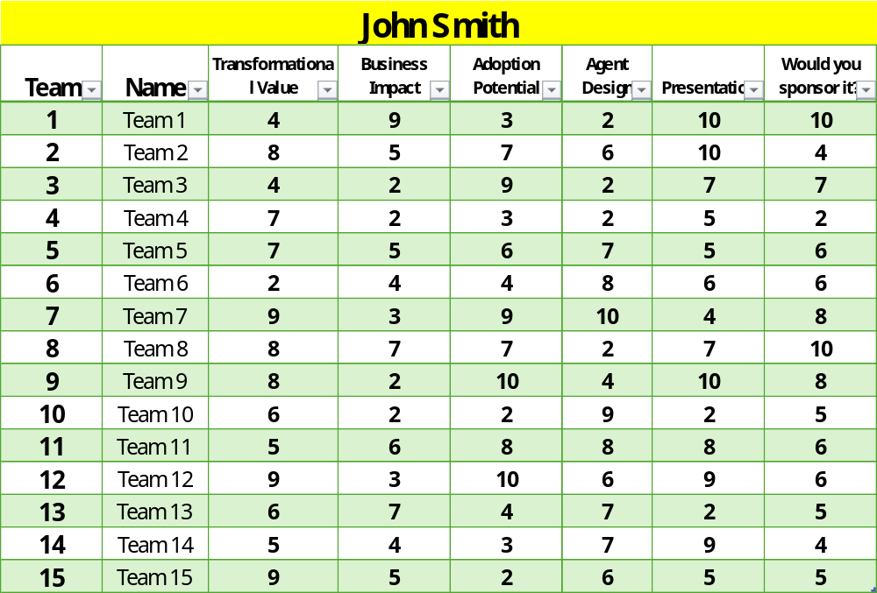
How to fill out scorecard
Fill in your Name
Blank Judges Template
Completed Example:
Fill in the Team Name
Fill in the Scores (1 = Low, 10 = High)

Slide 3
Scoring Guide
Score each category from 1 - 10
Maximum score per Group: 60.
Equal weight across all criteria.
Use descriptions in Rubric below as Guidance
Final score will be the Average Score across all judges
There will be 3 winners in total. If there are any Ties, the Customer’s Judges get the final say
You can call out 2 Teams for notable mentions, e.g. Most Creative, Most likely to fund.
Score | Transformational Value | Business Impact | Adoption Potential | Workflow Design | Presentation | Would You Fund It?
1–2 (Poor) | Limited / no improvement | Unclear impact and audience | Low adoption potential | Poorly designed, unrealistic workflow | Difficult to follow & unclear value | No
3–4 (Fair) | Minor improvement | Some clarity on impact and audience | Limited adoption potential | Weak design, with some plausible functionality defined | Basic explanation with limited value | Weak investment case
5–6 (Good) | Clear improvement | Clear impact with targeted audience | Moderate adoption potential | Well designed, with reasonably well-defined functionality | Clear presentation and understandable value | Worth exploring or piloting further
7–8 (Strong) | Major improvement | Major impact with clear benefits and targeted audience | Major adoption potential | Thoughtfully designed workflow, realistic functionality | Engaging presentation with strong value | Strong candidate for sponsorship
9–10 (Exceptional) | Completely changes how work is done | Critical impact with compelling value across a well-defined audience | Compelling adoption potential, strong demand for usage | Exceptionally designed & purposeful | Outstanding storytelling, demo, and communication of value | Would actively champion and prioritise sponsorship

